Slide 1

Web Scraping Project
Son Nguyen
June,2022

Slide 2


Contents
What & Why Rover.com
Algorithm for scraping data
Data collected
Analysis and visualization
Conclusion
Challenges
To do more

Slide 3
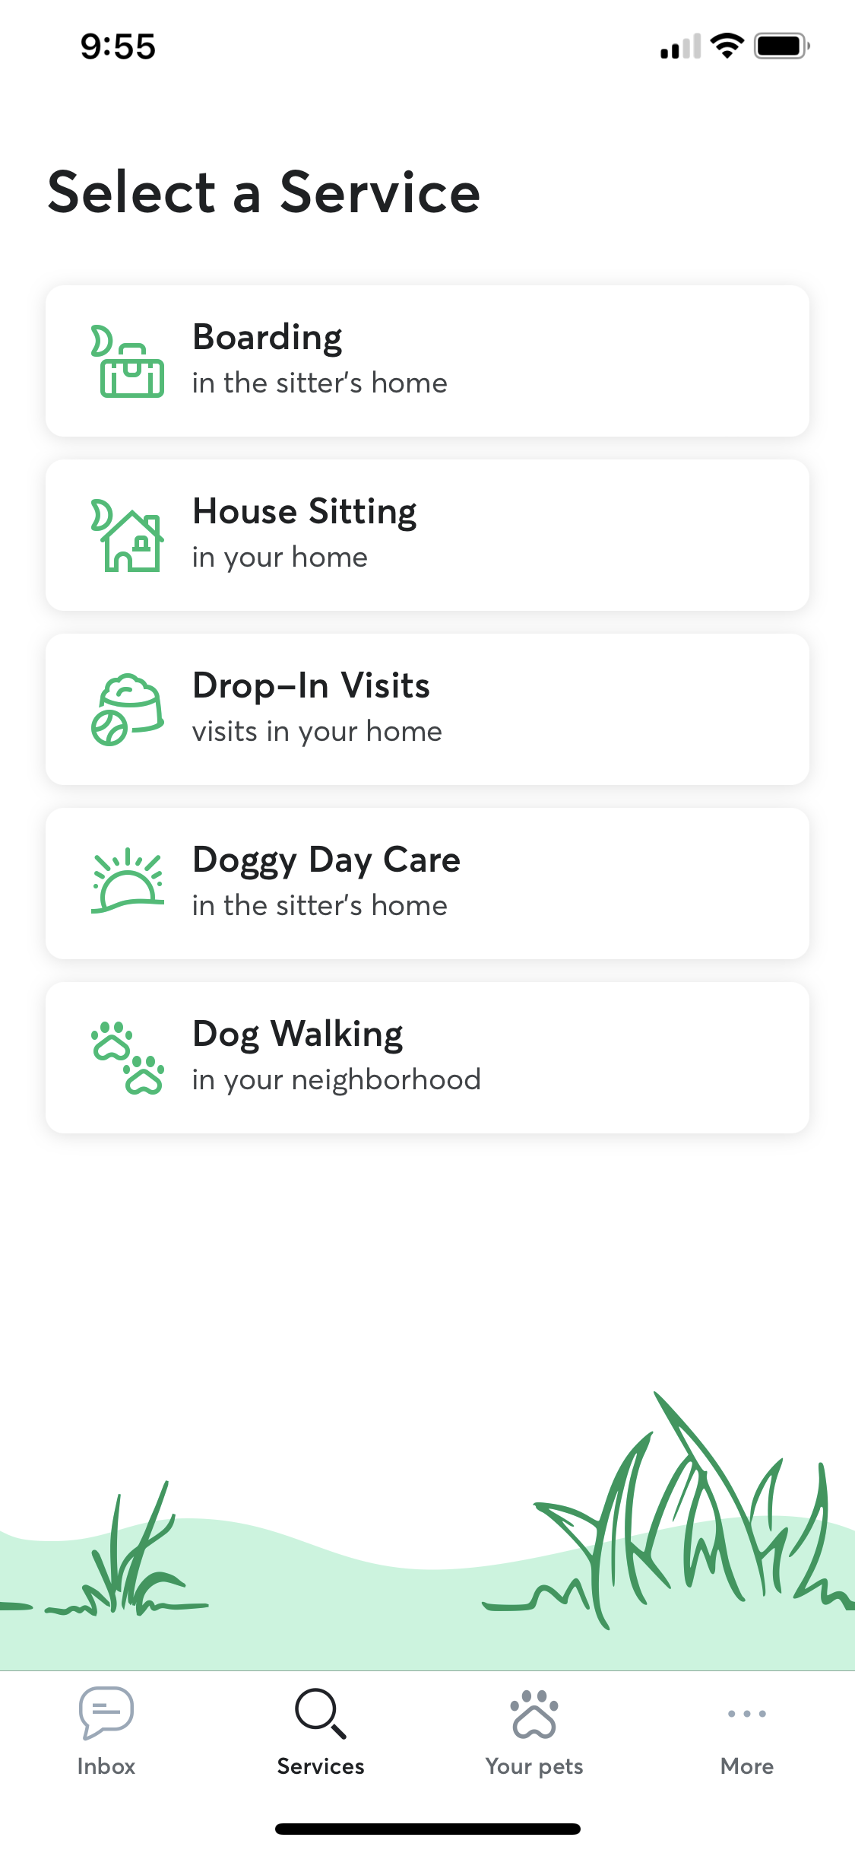
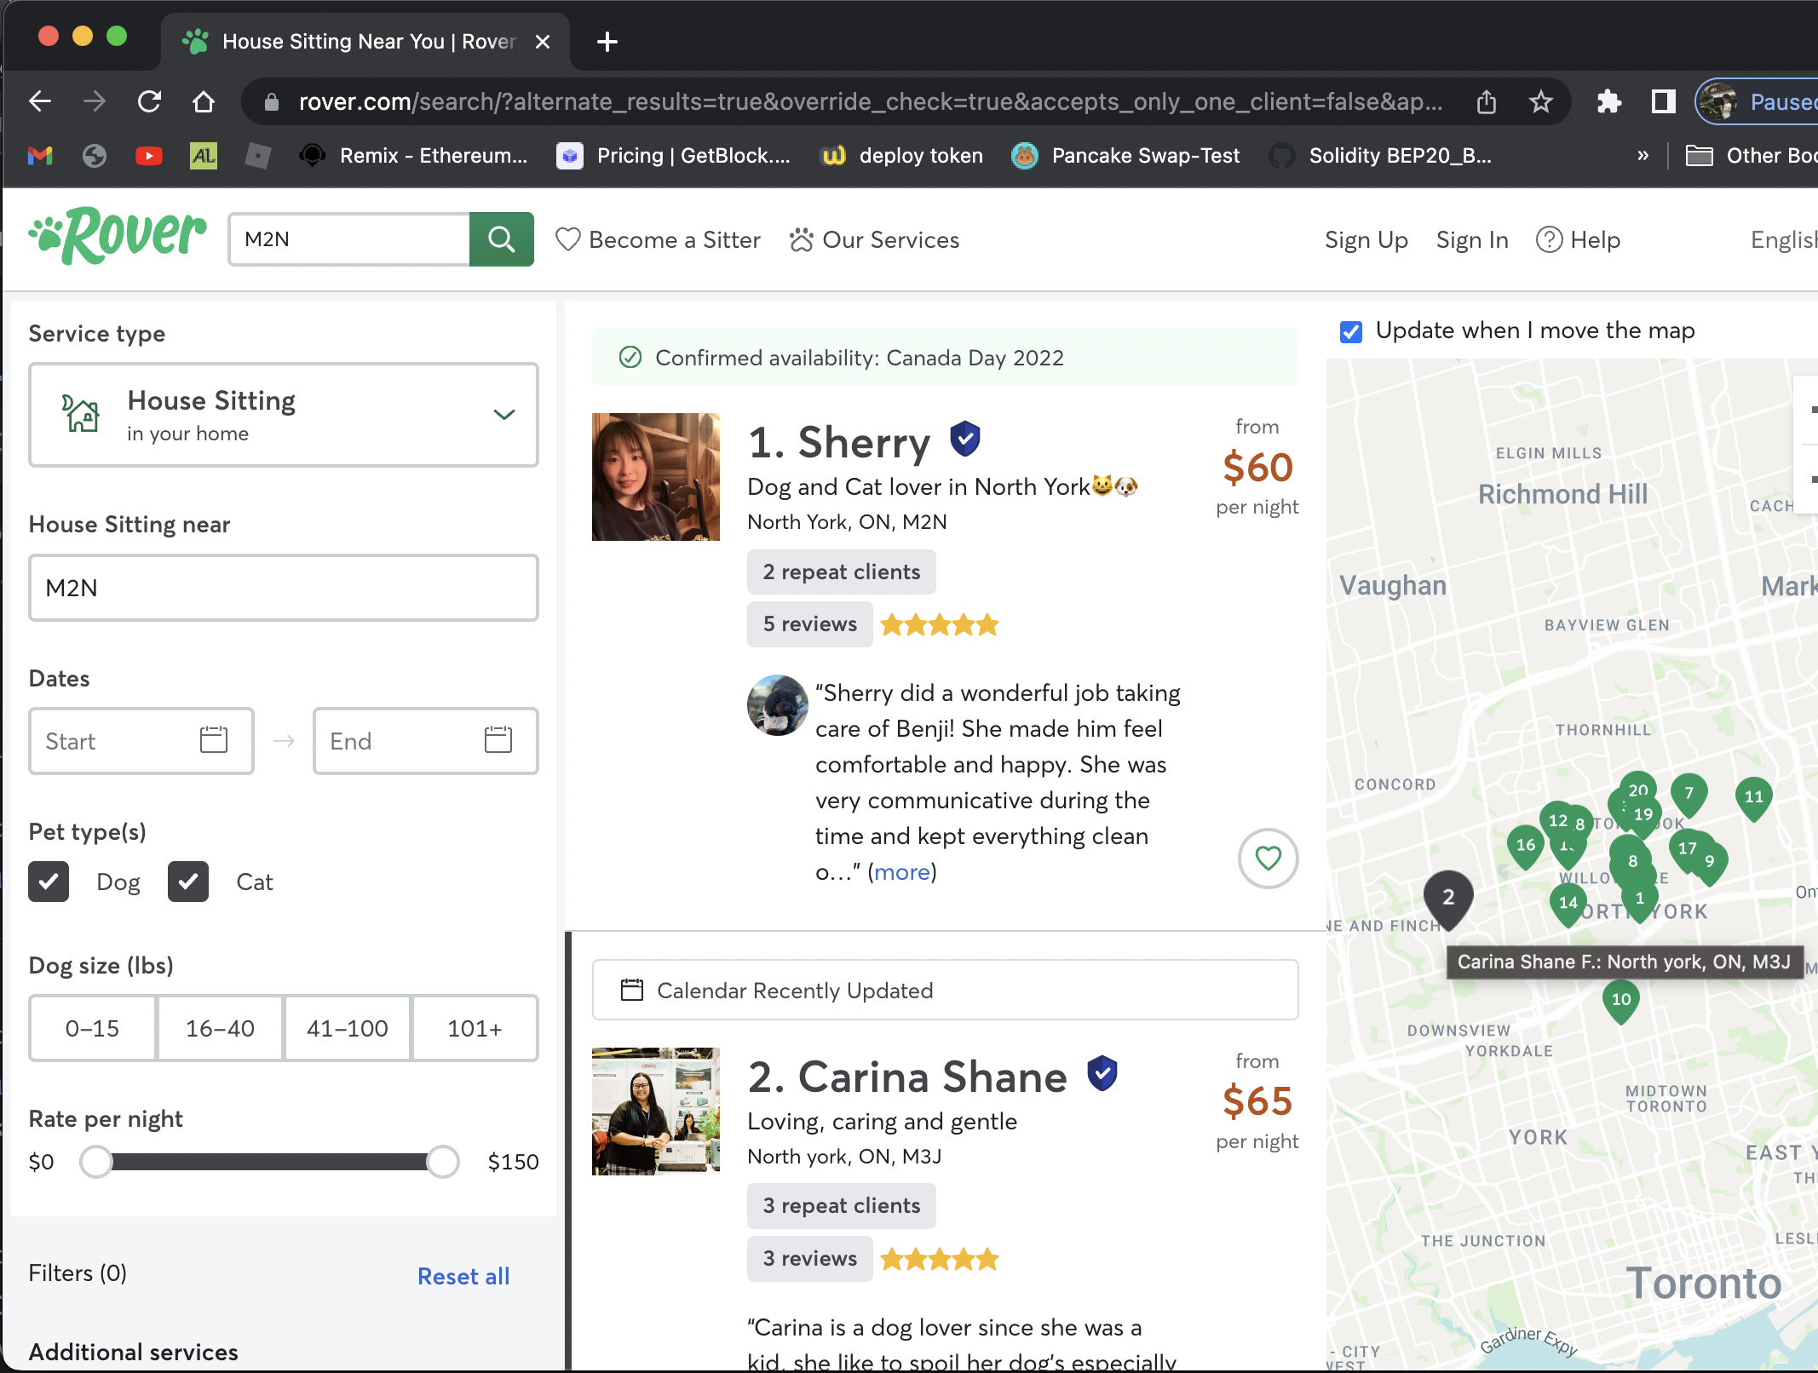
About Rover
The world’s largest network of 5-star pet sitters and dog walkers
Founded 2011
Headquarter in Washington, USA
Cover USA, Canada & Europe
Interface in both web & app

Slide 4
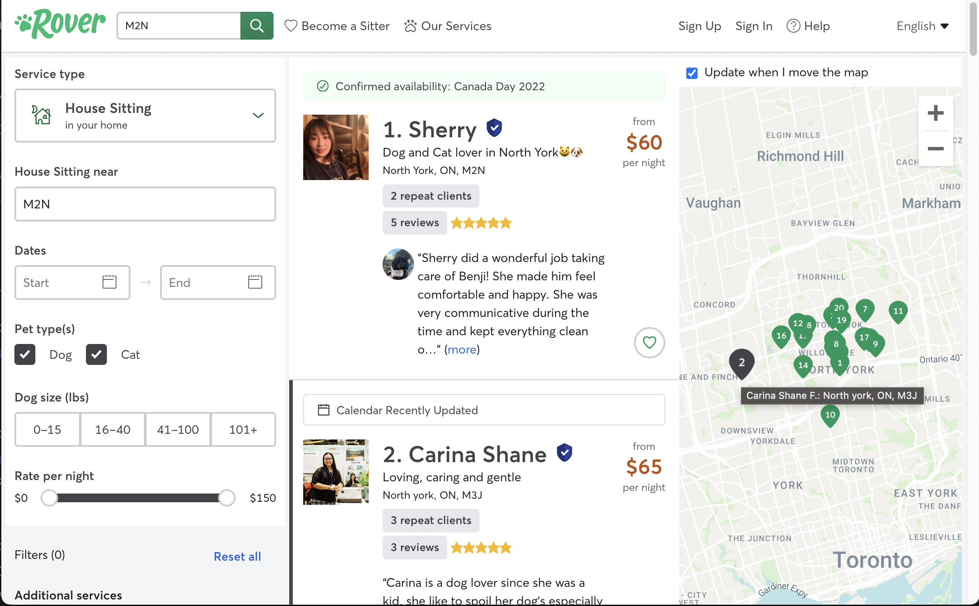
Algorithm
Search by cities/ postcode…
Create list of cities/ postcode in csv file.
Click next each page until end.
Scroll up & down to make sure all information are loaded
Parse sitter in another driver
Scroll up and down to make sure all data loaded.
Search by each location then extend the map to maximum (around 400km)
Parse each page
Check whether the sitter exists, if not → scrap it.
Save to csv file after finish one page.
Use BeautifulSoup to get all data need

Slide 5
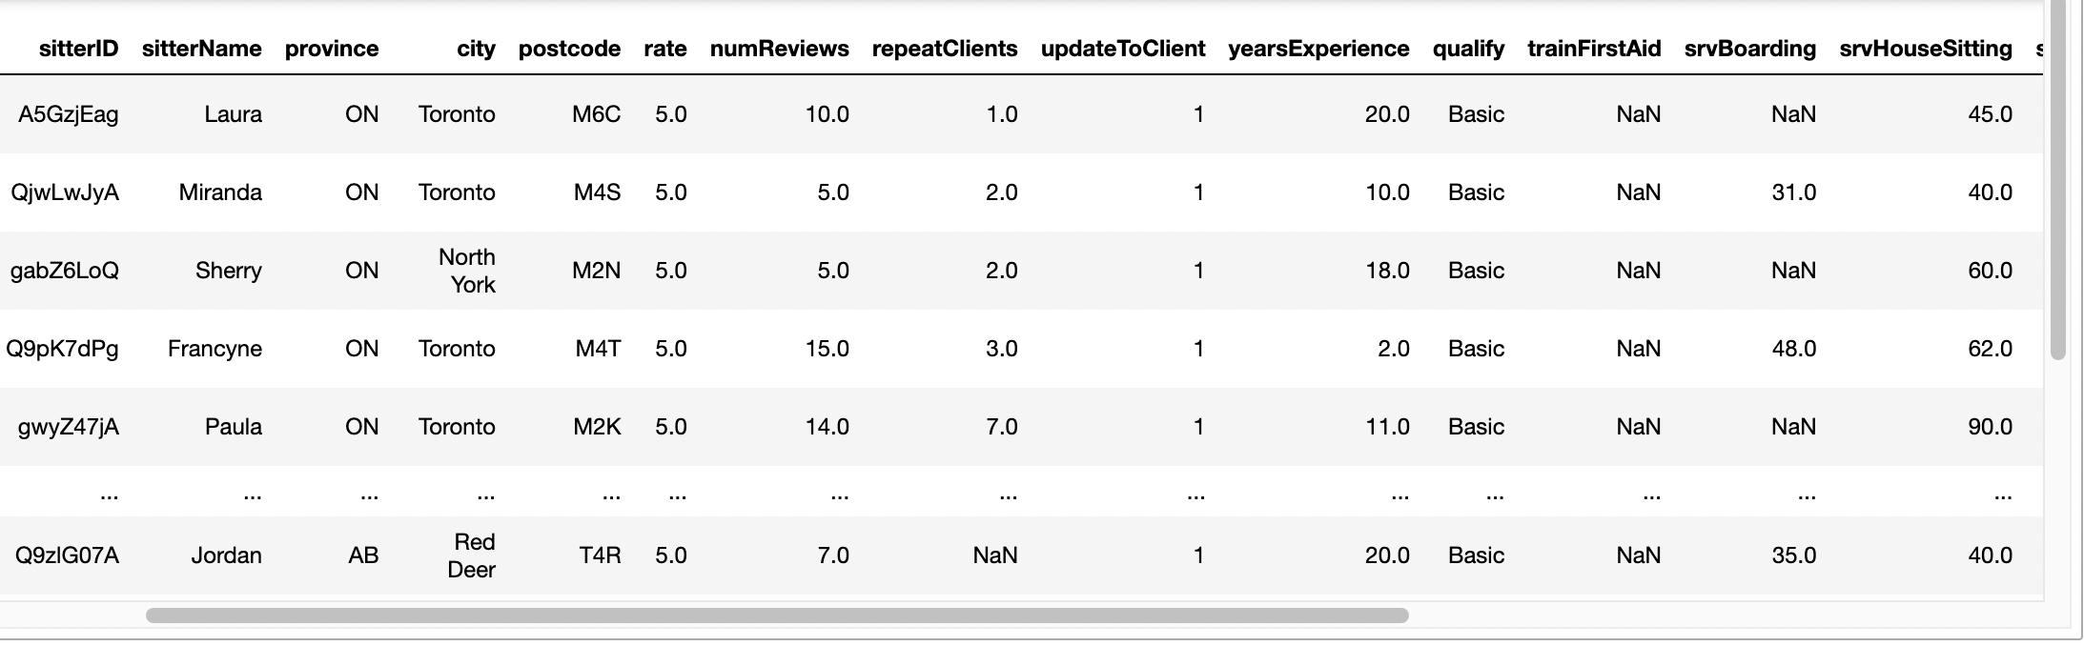
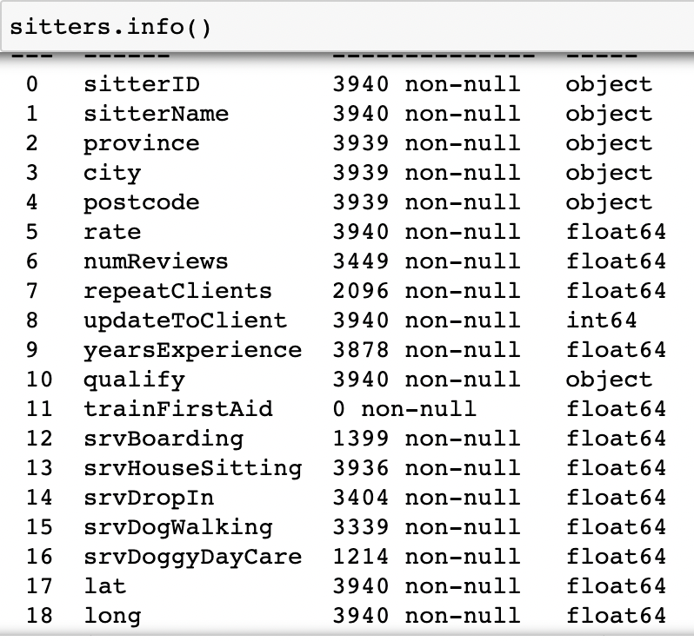

Data collected

Slide 6
Contents
What & Why Rover
Algorithm for scraping data
Data collected
Analysis and visualization
Conclusion
Challenges
To do more

Slide 7

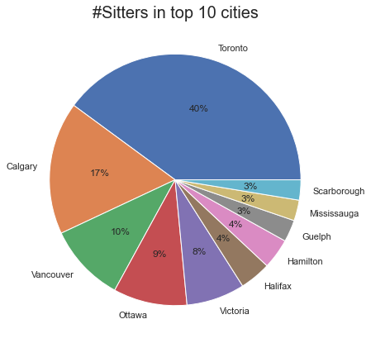
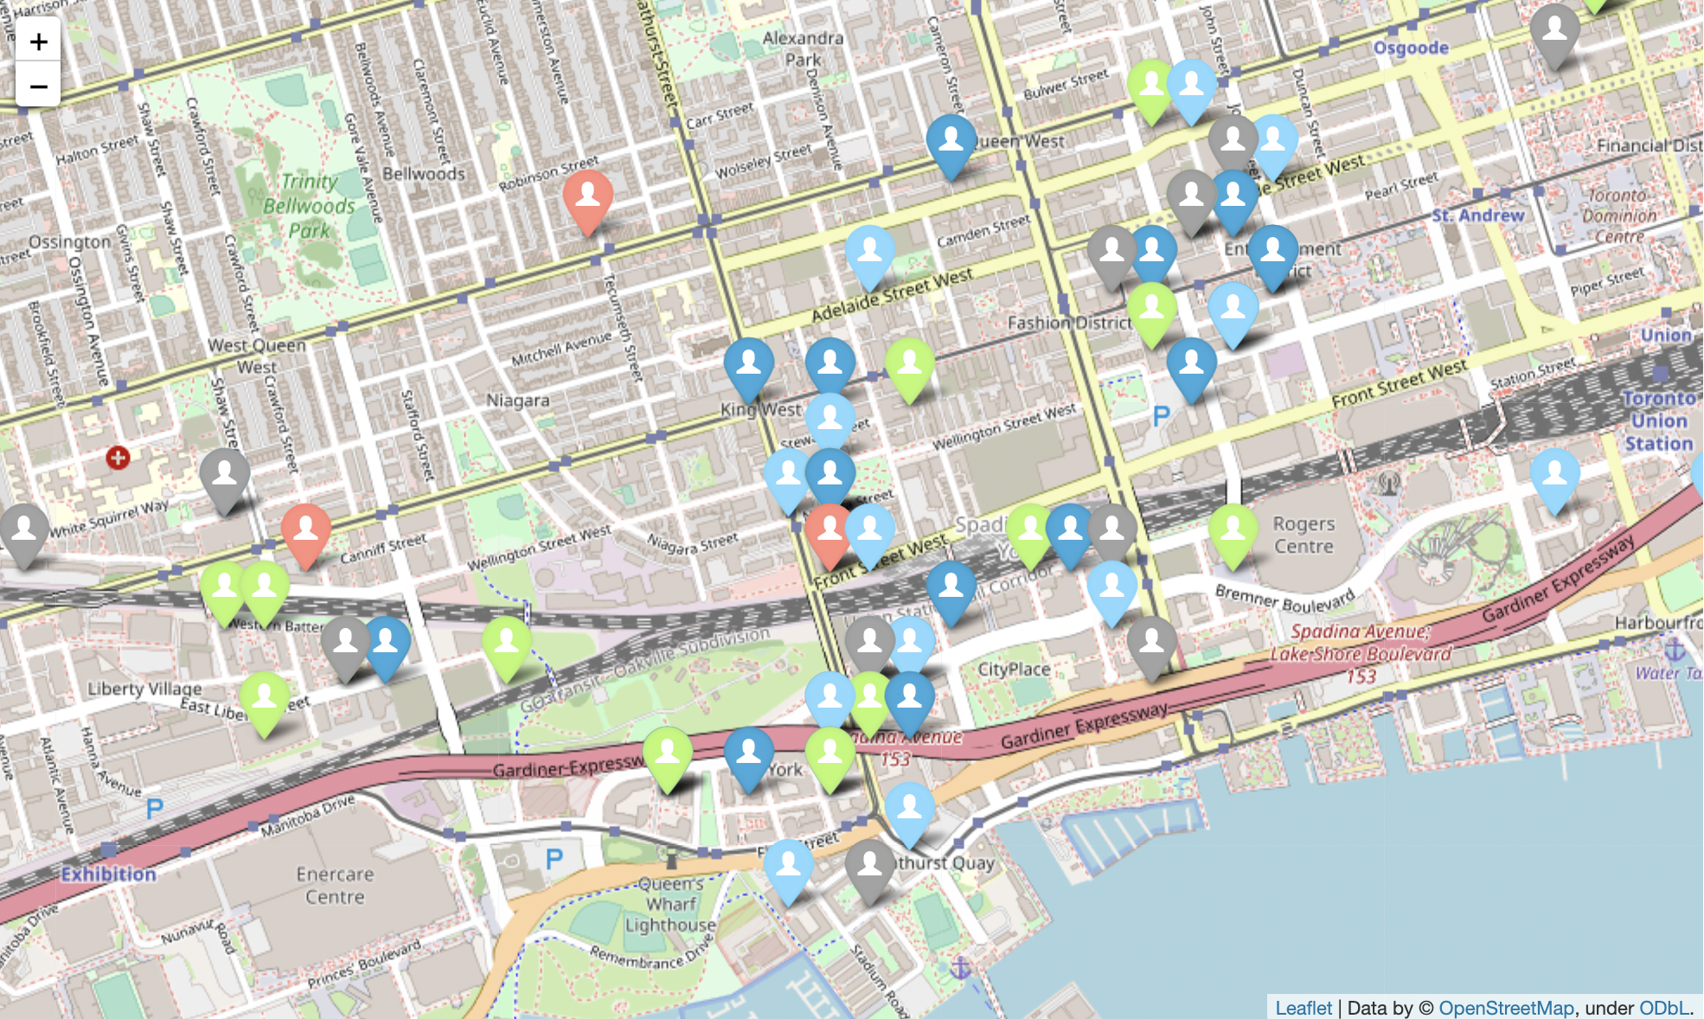
Sitters' density

Slide 8
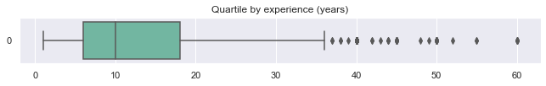
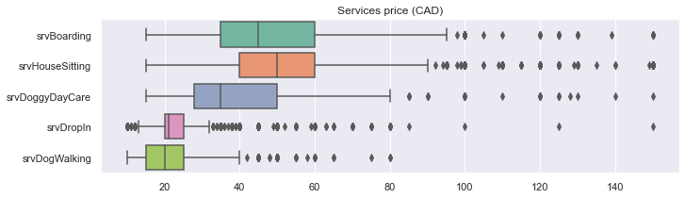
Quartile by experience & price of services

Slide 9
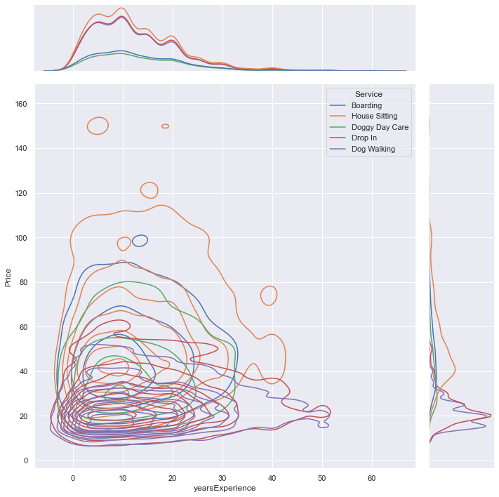
price by each service & experience

Slide 10
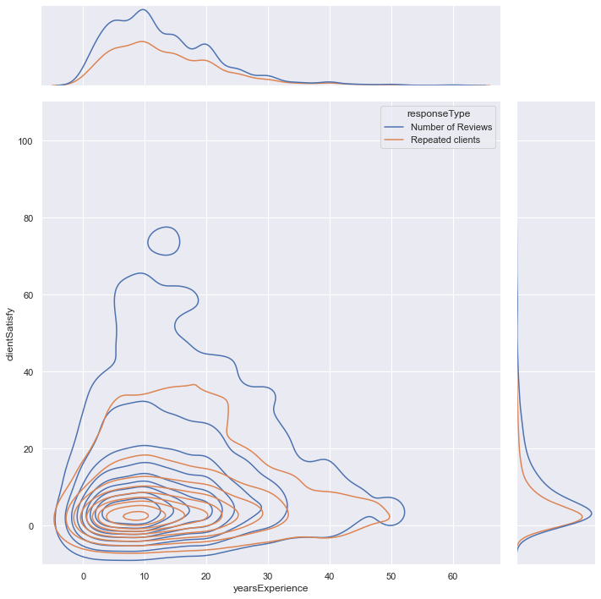
Customer satisfaction

Slide 11
conclusion
Rover.com has become the largest service marketplace for pet owners
The company grows very fast, but still has high potential.
The range of price (min-max) rather high. It should have a standardize for it.
Website runs fast and user oriented. I learn much from that, but it challenge the scrapper also.

Slide 12

challenges
Updated selenium has some differences to the lesson
Some problems with webdriver (chrome) in Mac OS
So much functions in Python to remember enough
Using pandas
Understand kinds of chart then choose the suitable to use.

Slide 13

to do more…
Adjust the algorithm to scrap the whole Canada.
Getting the information about population, population density, GDP then binding with sitters’ density to find out the relevant between them .
Point out the territories have potential for sitters and marketing.

Slide 14
